Slide 1

SSID: zenguest
Password: password
Notes:
Please remove this slide when sharing the document to the public

Slide 2
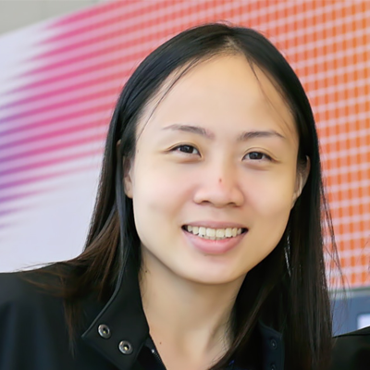
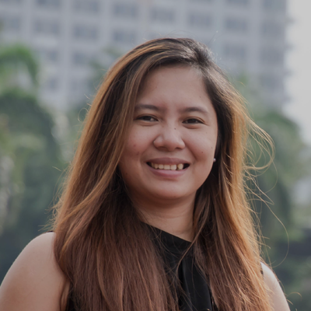
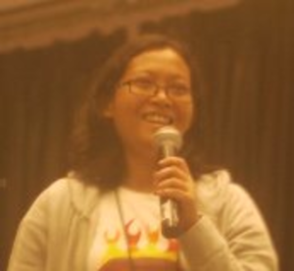
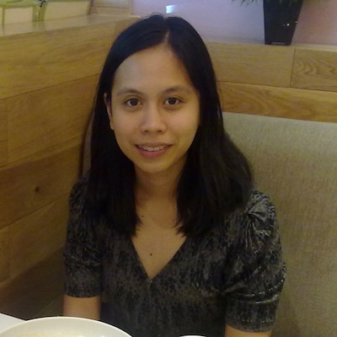
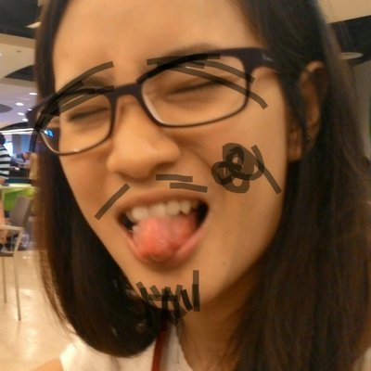
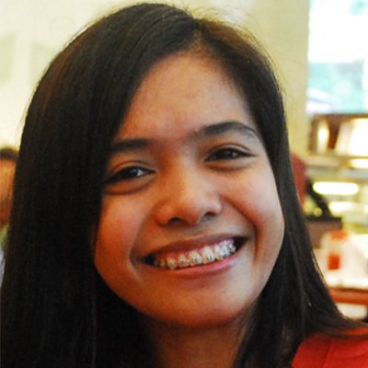

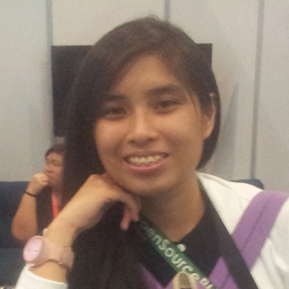
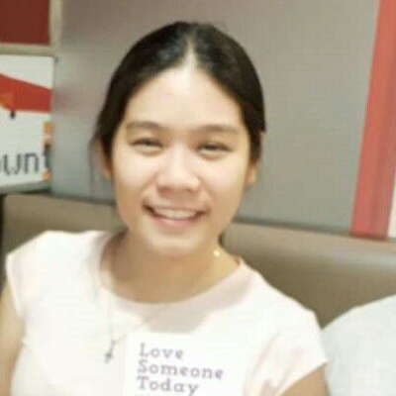

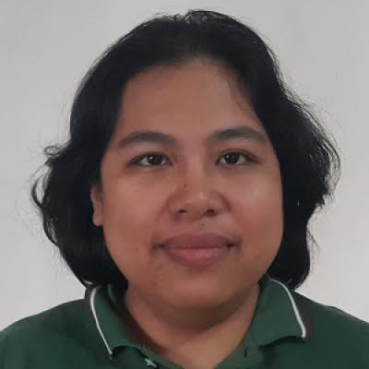
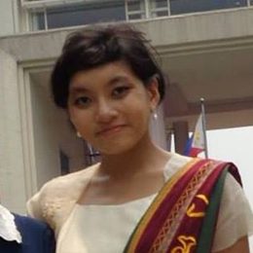
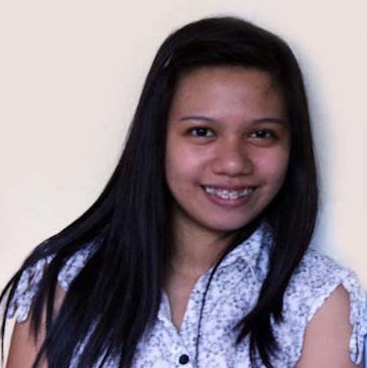
Artificial Intelligence Study Group
Twitter: @wwcodemanila
FB: fb.com/wwcodemanila
#WWCodeManila
#AI
#StudyGroup

Slide 3
Issa Tingzon
Research Fellow
PCARI
Notes:
Please use only the three colors for the content.

Slide 4
New Member’s Introduction

Slide 5

I am <name>
<your current profession>
<why did you join this study group?>
Notes:
Please use only the three colors for the content.

Slide 6
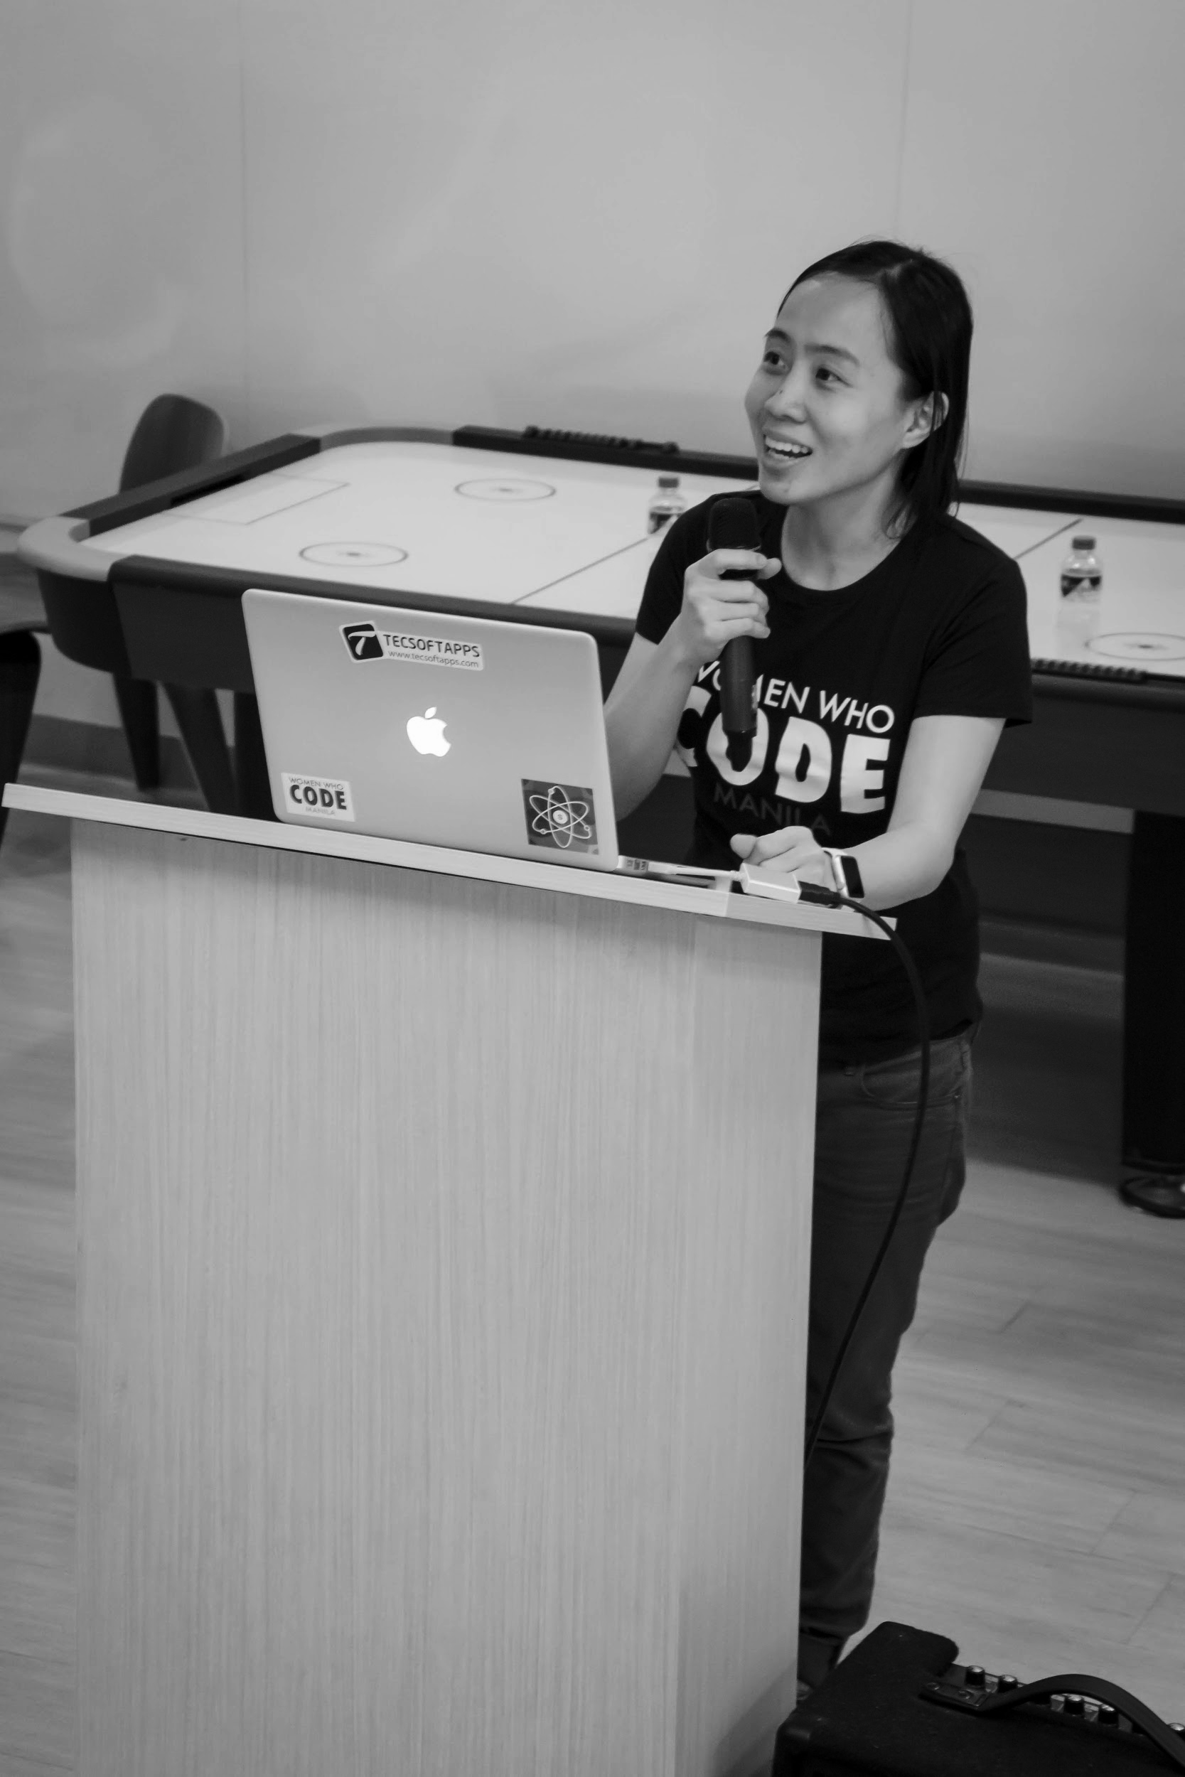

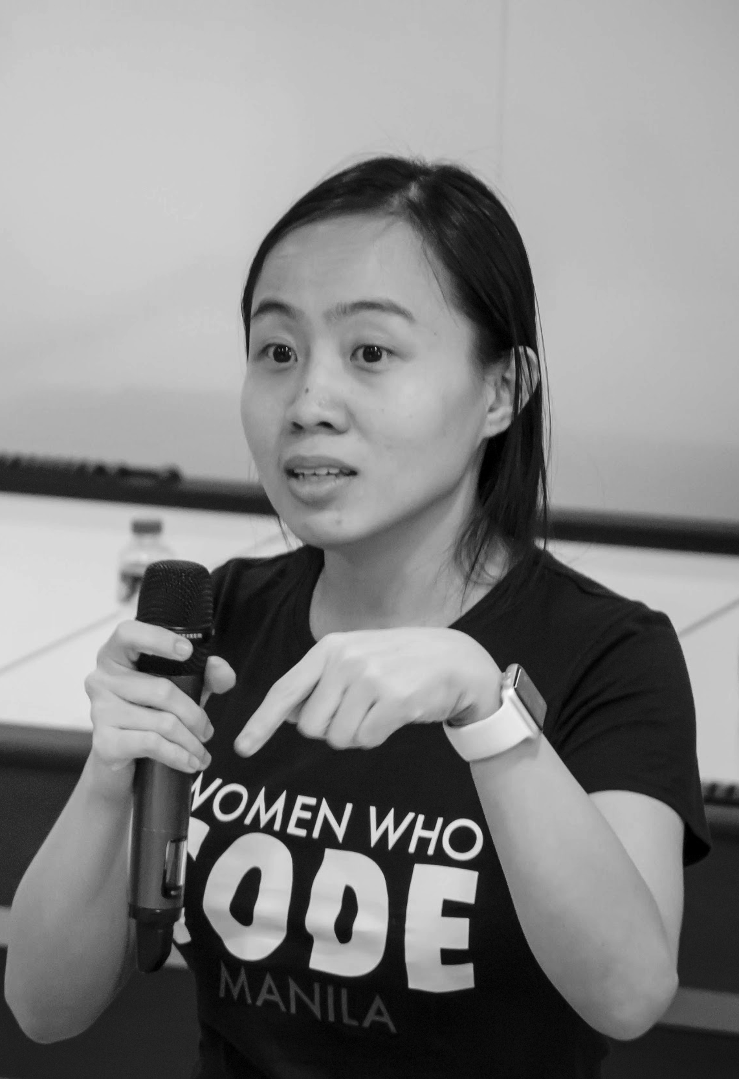
OUR MISSION
Inspiring women to excel in technology careers.

Slide 7
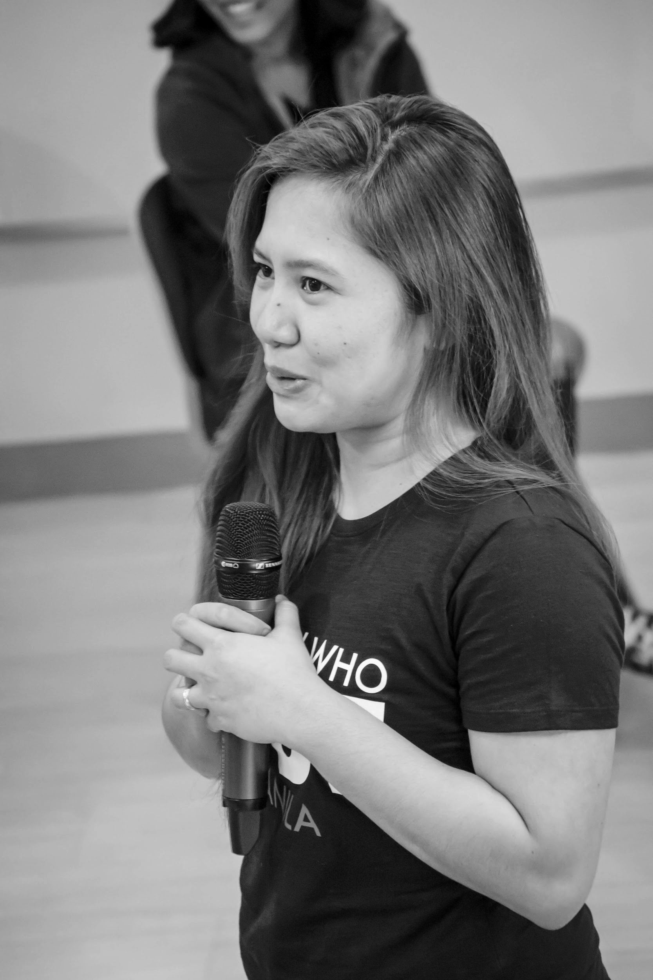
OUR VISION
A world where women are representative as technical executives, founders, VCs, board members and software engineers.

Slide 8
STUDY GROUP
Study groups are events where women can come together and help each other learn and understand a specific programming language, technology, or anything related to coding or engineering.

Slide 9
GUIDELINES
If you have a question, just ask
If you have an idea, share it
Make friends and learn from your study groupmates
Do not recruit or promote your business

Slide 10
SHOW & TELL
Notes:
Please use only the three colors for the content.

Slide 11
DECISION TREES
TOPIC FOR TODAY

Slide 12
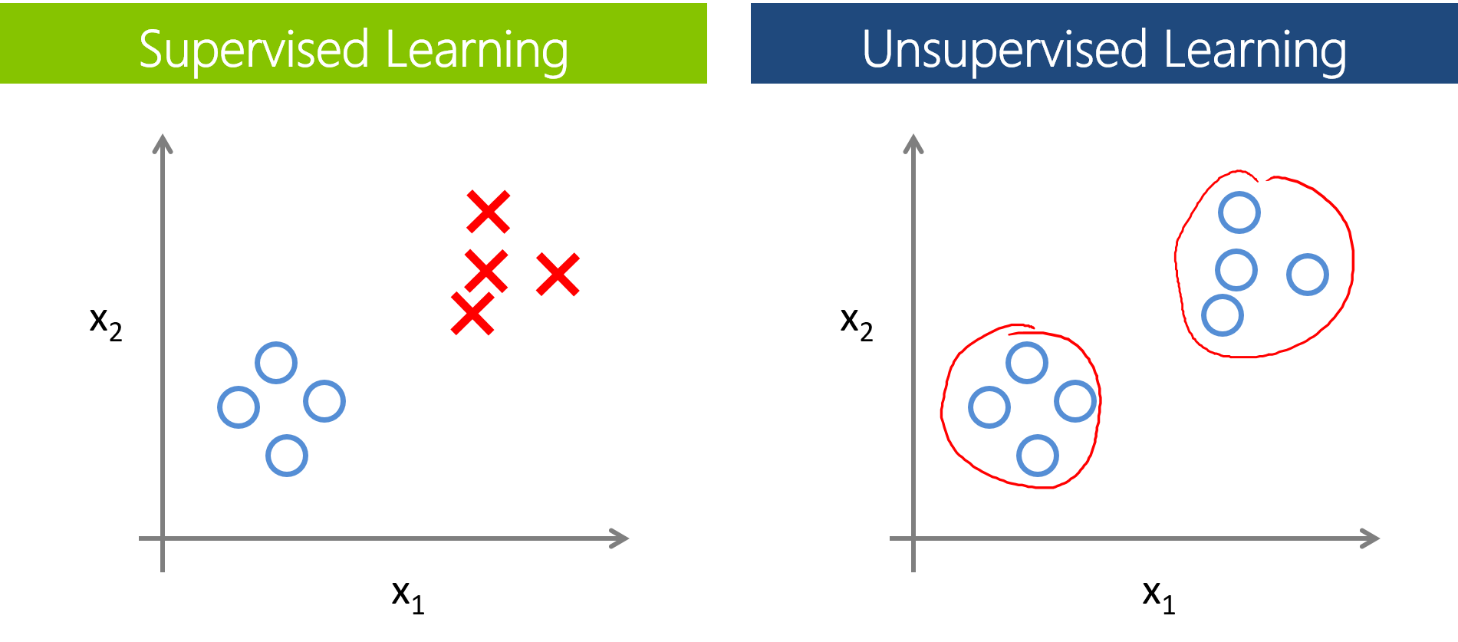
REVIEW
Two types of ML Algorithms:
Supervised
Data is labelled
Goal: Predict or classify data
Unsupervised
Data is unlabelled
Goal: Uncover patterns or structure in data

Slide 13
DECISION TREES
A type of supervised learning algorithm
Interpretable; mimics human decision making

Slide 14

If Salary > $50,000 and commute is not more than 1 hour and offers free coffee, then accept offer!

Slide 15
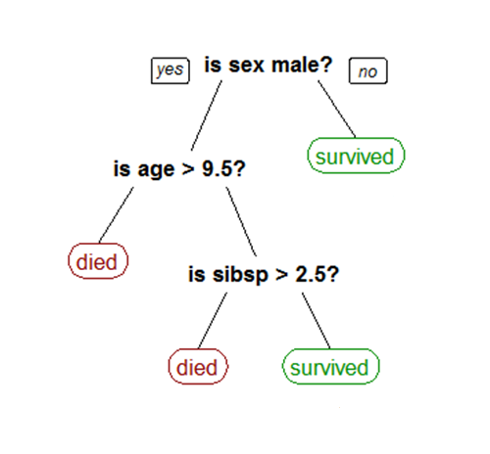
Would you survive the sinking of the Titanic?

Slide 16
TERMINOLOGY
Root Node: represents the entire training set
Splitting: process of dividing a node into two or more subsets/nodes
Internal/Decision Node: corresponds to an attribute
Leaf/Terminal Node: corresponds to a class label

Slide 17
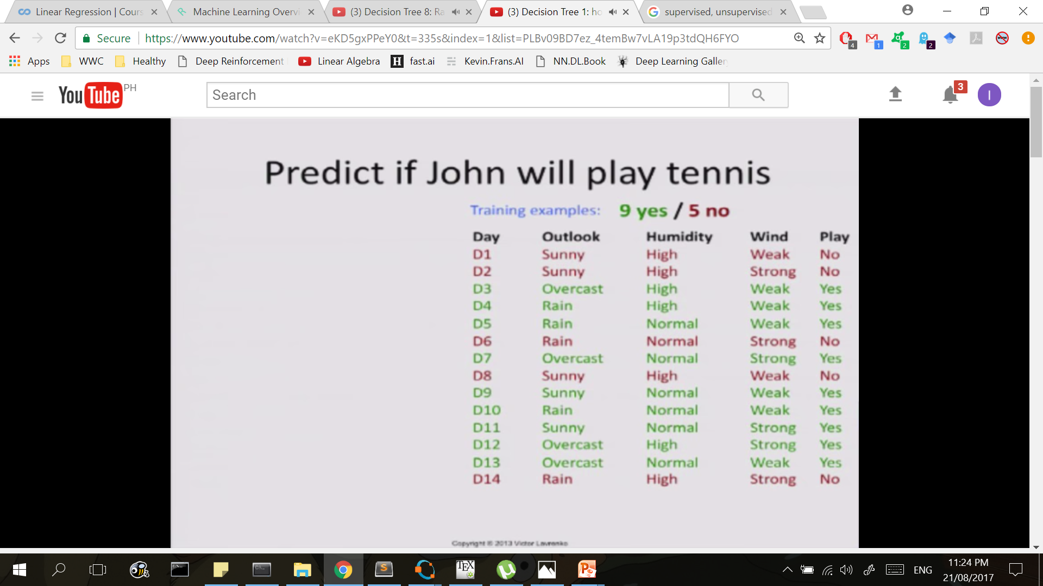
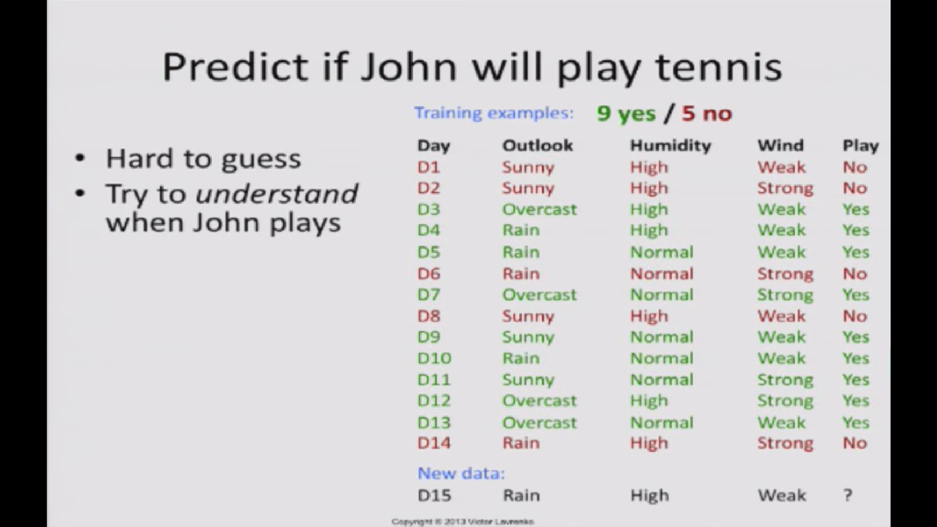
Predict if John will play tennis
Hard to guess
Try to understand when John plays tennis

Slide 18
Predict if John will play tennis
Divide and Conquer
Split into subsets
Are they all “pure”?
If yes: stop
If not: repeat
See which subset new data falls into

Slide 19
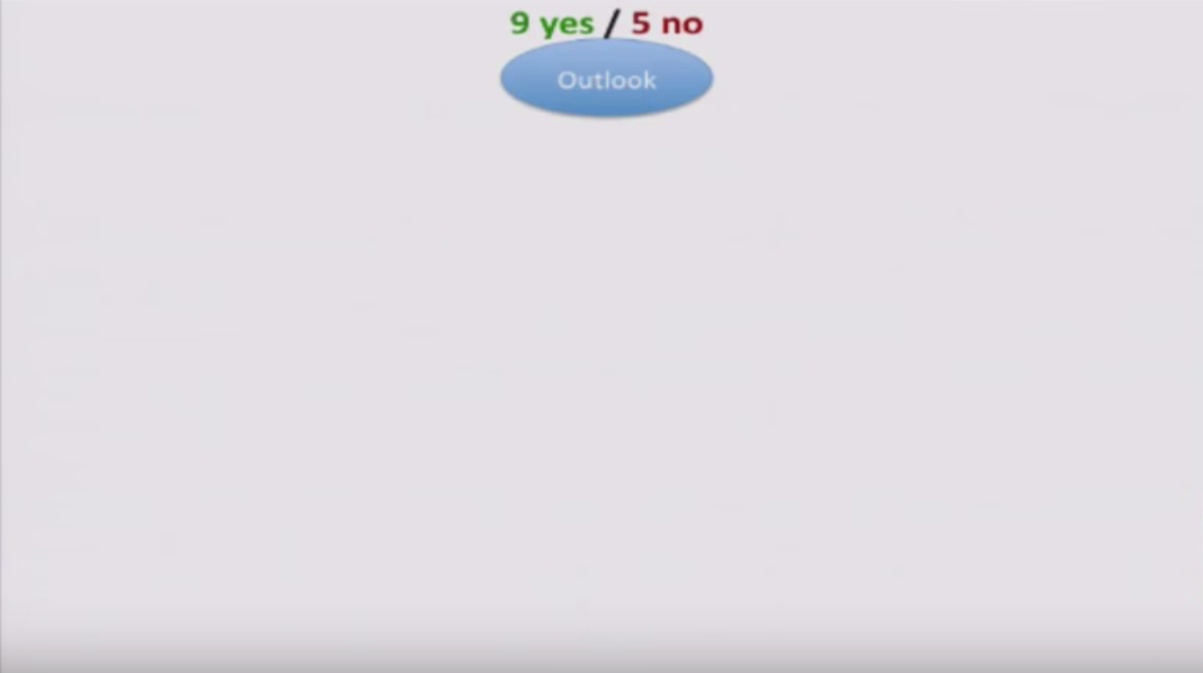

Slide 20
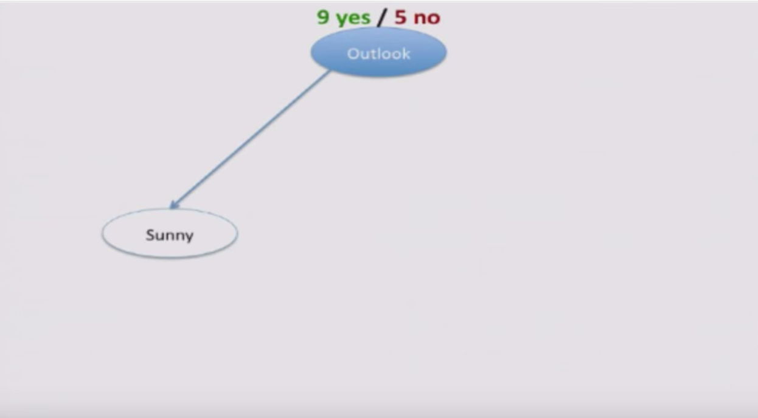

Slide 21
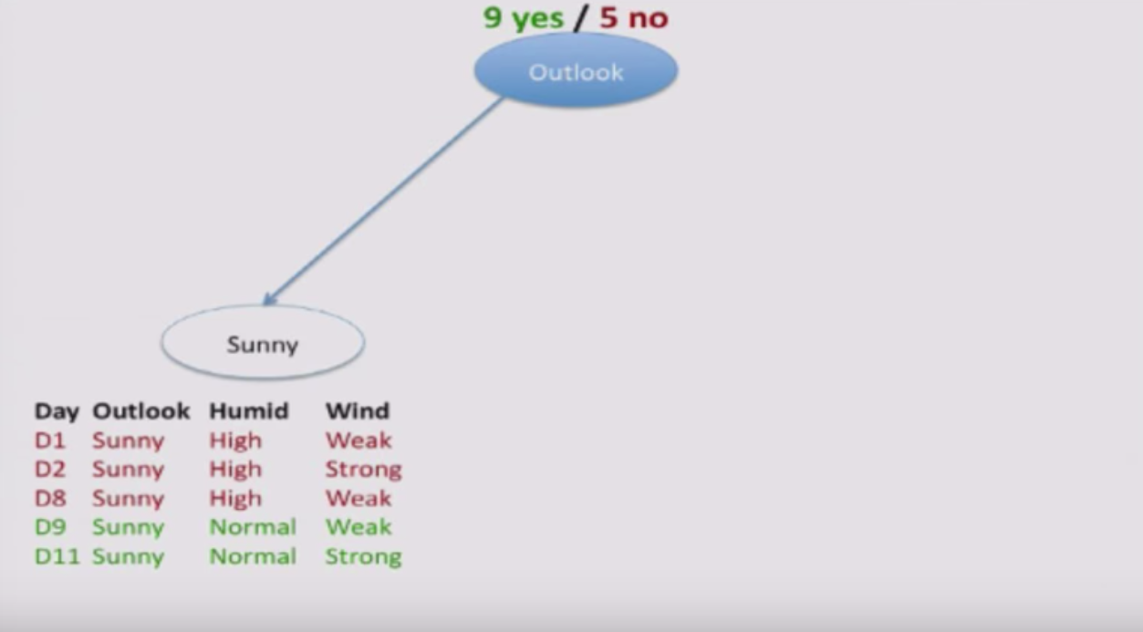

Slide 22
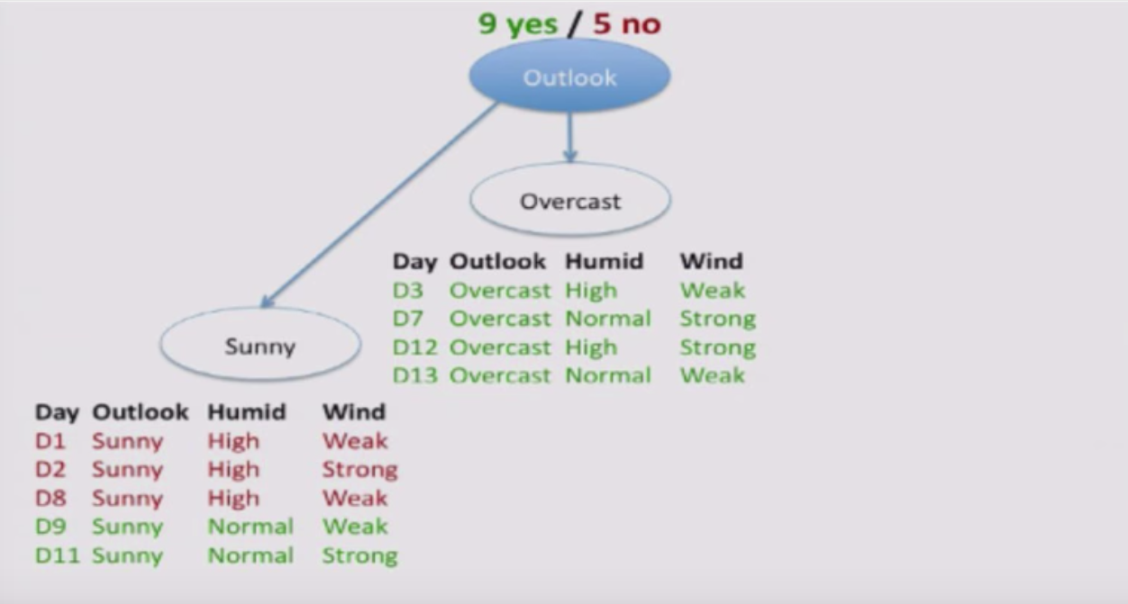

Slide 23
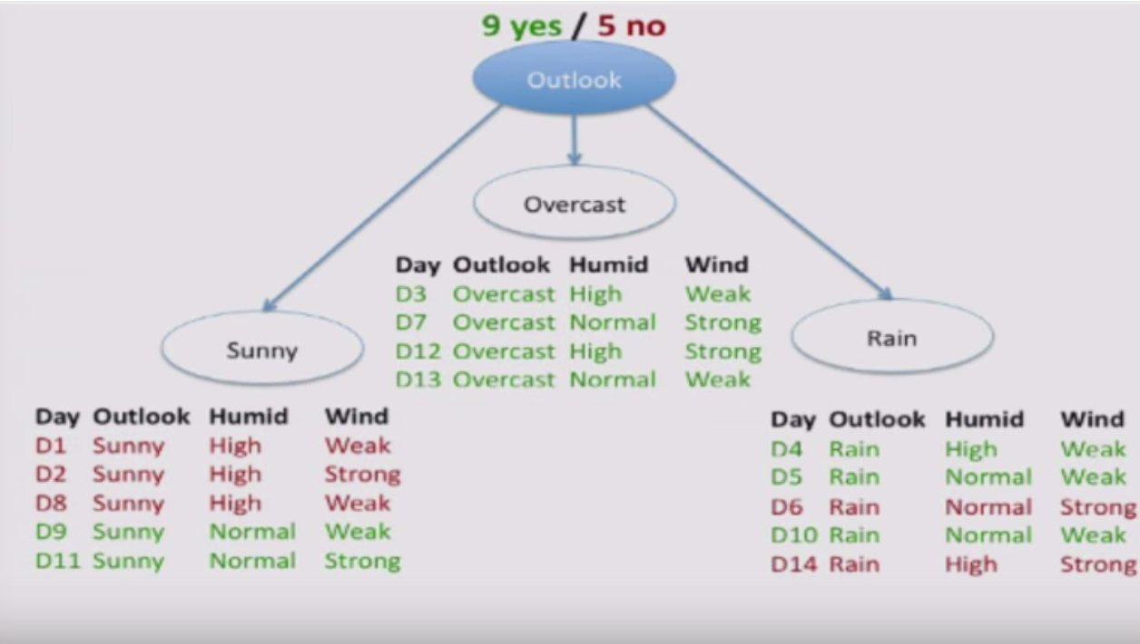

Slide 24
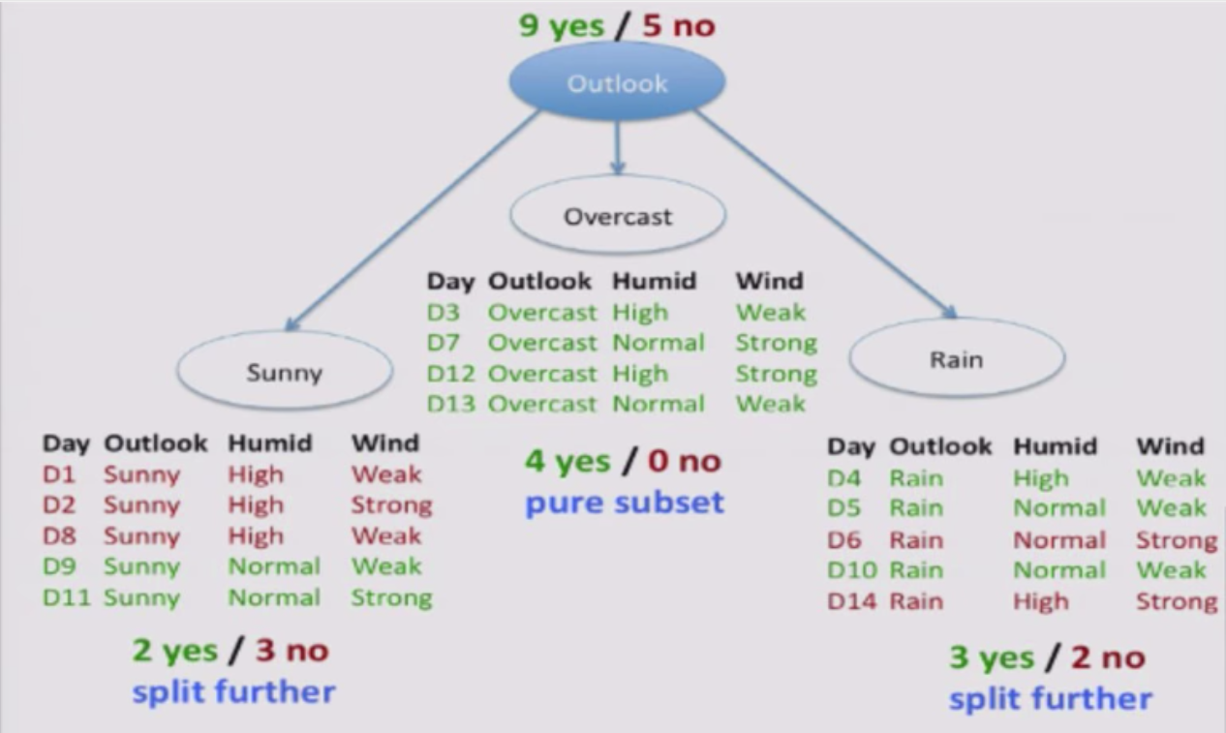

Slide 25
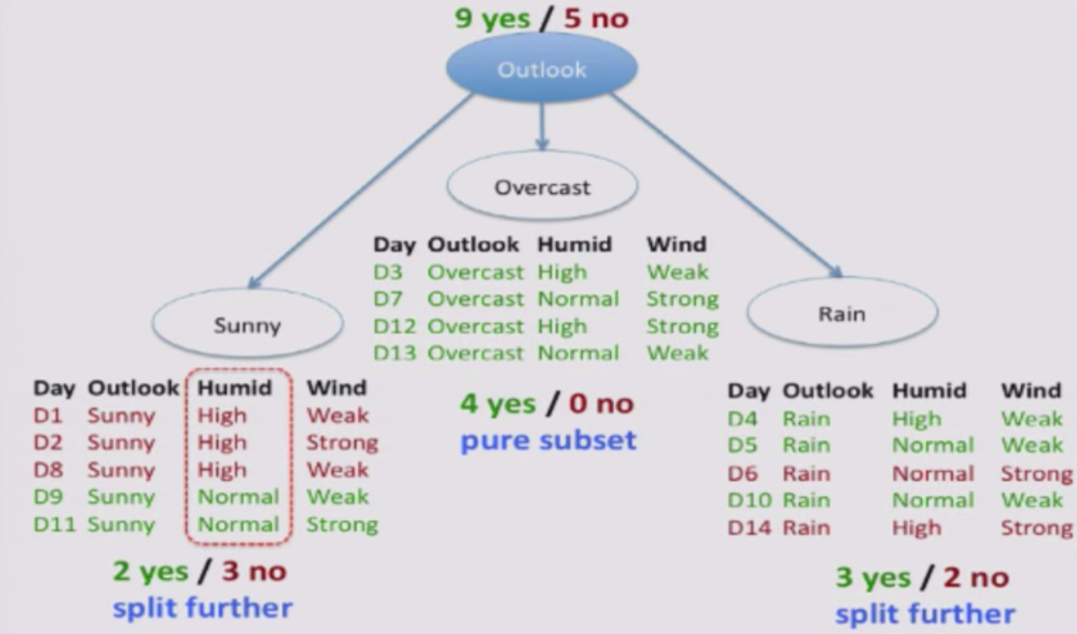

Slide 26
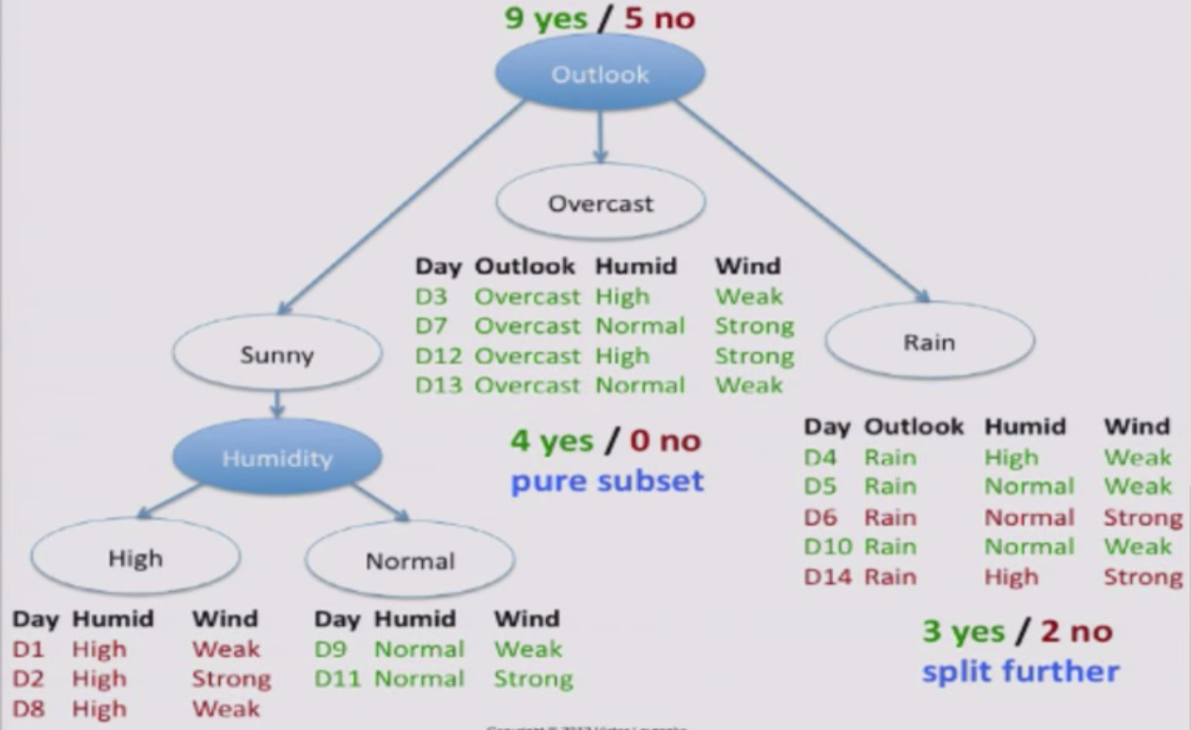

Slide 27
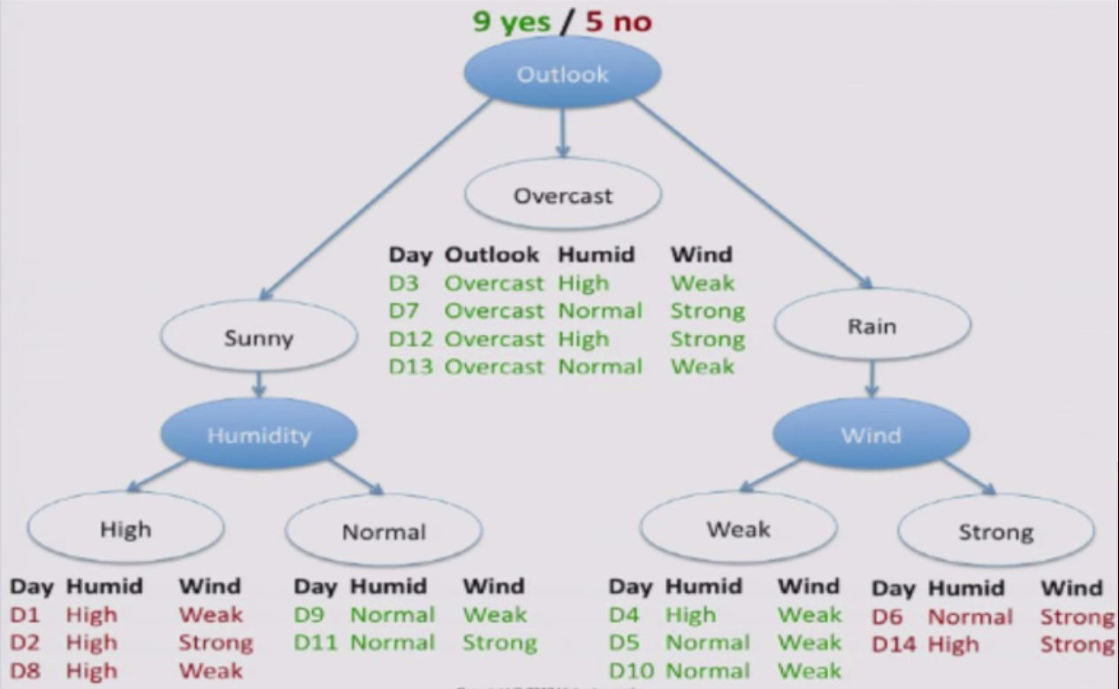

Slide 28
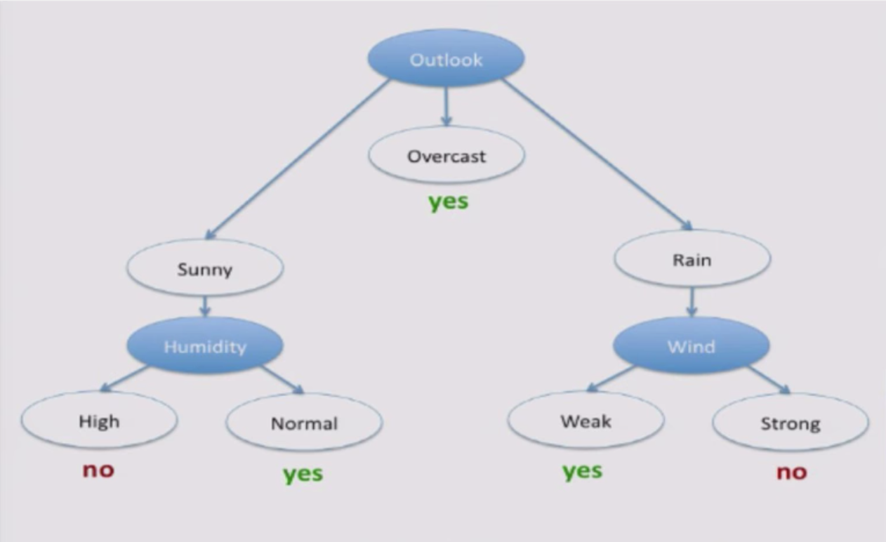

Slide 29
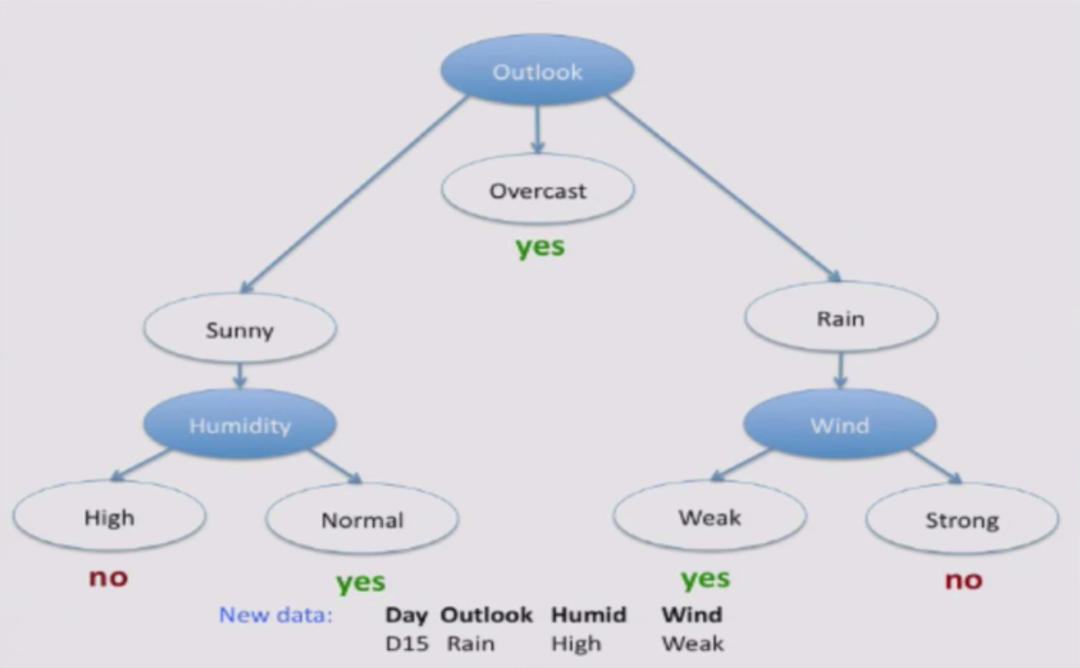

Slide 30
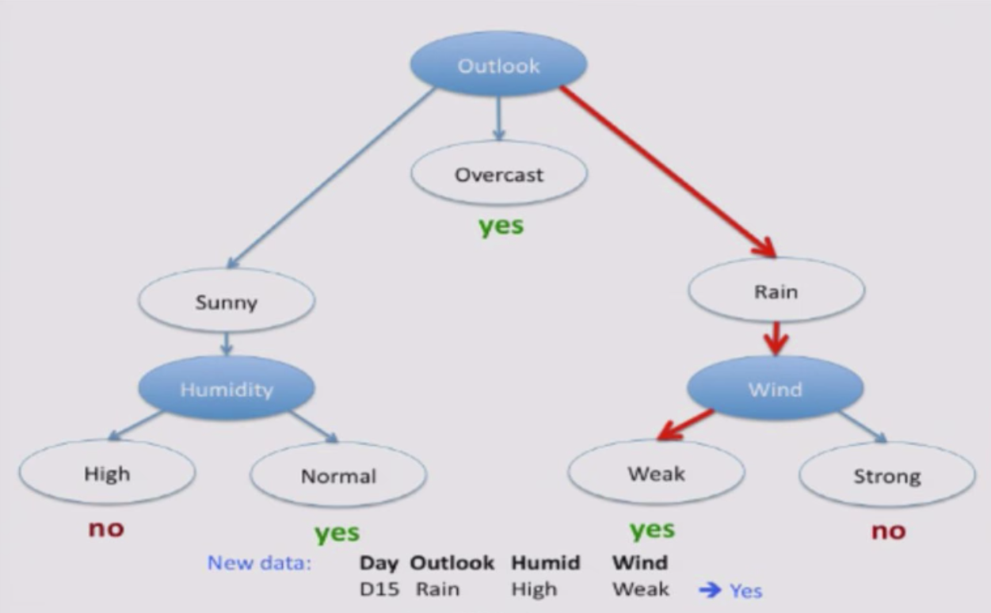

Slide 31


Slide 32
ID3 Algorithm
ID3 - Ross Quinlan, 1986; CART - Briemanetal, 1984
Suppose feature A is the best attribute to split on.
Split entire training set on attribute A
For each subset/ child node:
If subset is pure: stop
Else: split subset

Slide 33
Which attribute to split on?
Want to measure the “purity” of the split
More certain about Yes/No after the split
Pure set → (4 Yes / 0 No) 100% certain
Impure Set → (3 Yes / 3 No) 50 % certain
Entropy – a way to measure certainty
Higher entropy → more uncertain

Slide 34
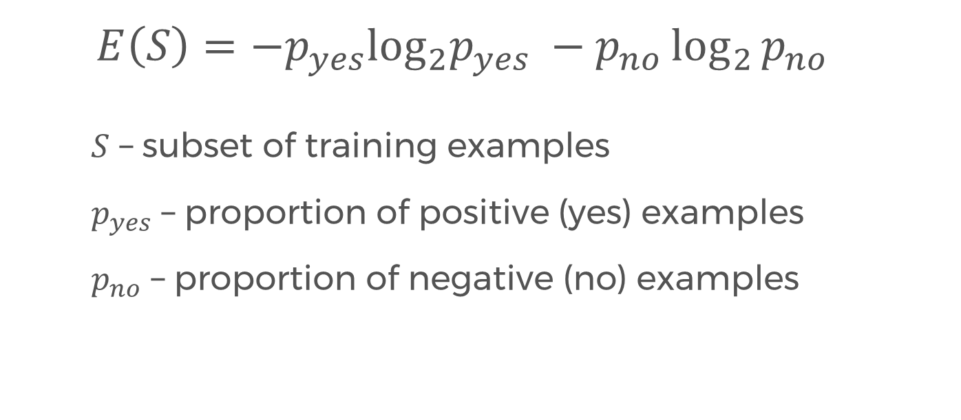
Entropy
$$E\left(S\right)=−p_{yes}\log_{2}p_{yes} −p_{no}\log_{2}{p_{no}}$$
$S$ – subset of training examples
$p_{yes}$ – proportion of positive (yes) examples
$p_{no}$ – proportion of negative (no) examples

Slide 35
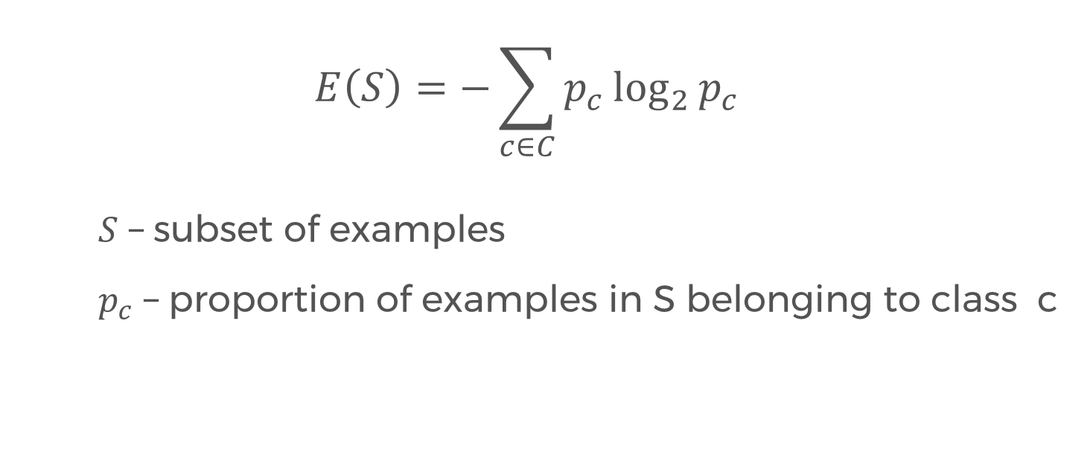
Entropy, more generally
$$E\left(S\right)=−\sum_{c∈C}{p_{c}\log_{2}{p_{c}}}$$
$S$ – subset of examples
$p_{c}$ – proportion of examples in S belonging to class c

Slide 36
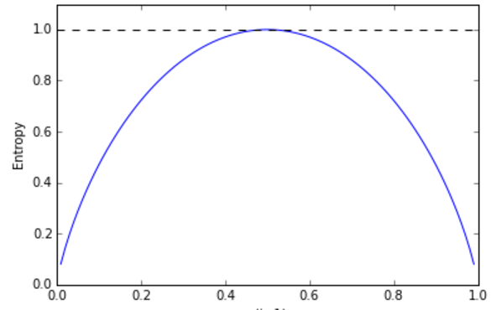
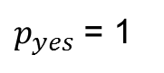
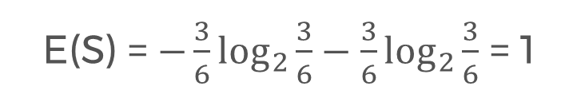
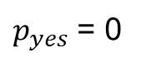
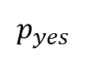
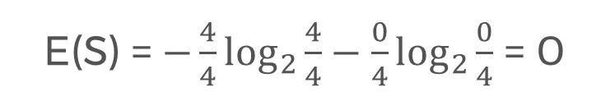
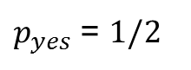
Entropy example
e.g. (3 yes / 3 no)
E(S) = $−\frac{3}{6}\log_{2}{\frac{3}{6}}−\frac{3}{6}\log_{2}{\frac{3}{6}}$ = 1
$p_{yes}$ = $1/2$
e.g. (4 yes / 0 no)
E(S) = $−\frac{4}{4}\log_{2}{\frac{4}{4}}−\frac{0}{4}\log_{2}{\frac{0}{4}}$ = 0
$p_{yes}$ = 0
$p_{yes}$ = 1
$$p_{yes}$$

Slide 37
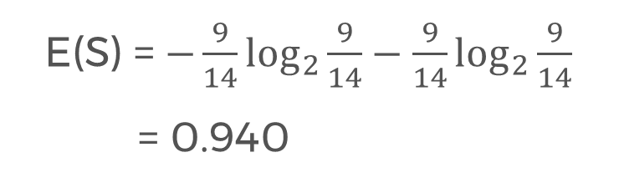
Entropy example
exercise: (9 yes / 5 no)
$p_{yes}$ = $1/2$
E(S) = $−\frac{9}{14}\log_{2}{\frac{9}{14}}−\frac{9}{14}\log_{2}{\frac{9}{14}}$
= 0.940
$p_{yes}$ = 0
$p_{yes}$ = 1
$$p_{yes}$$

Slide 38
Entropy
Entropy tells us how pure one subset is.
Now, we want to aggregate info on different subsets.
Simply averaging the entropies don’t work. (Why not?)
We want a measure of the effectiveness of an attribute in classifying the training data.

Slide 39
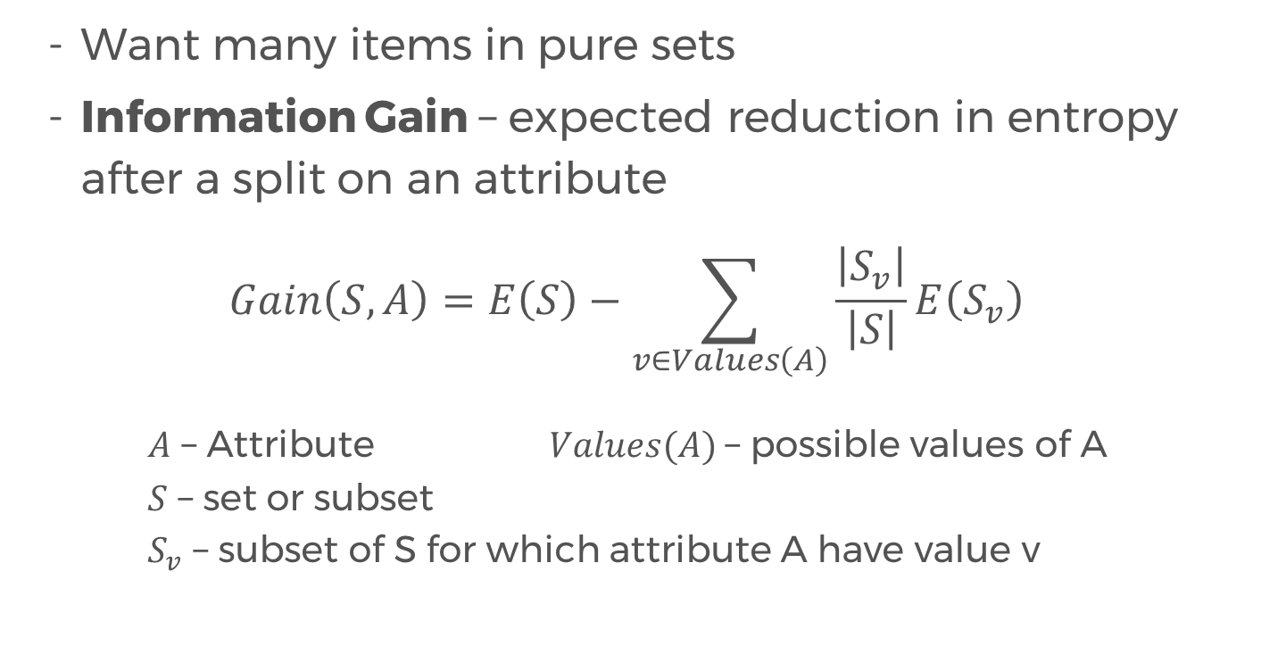
Information Gain
Want many items in pure sets
Information Gain – expected reduction in entropy after a split on an attribute
$$Gain\left(S,A\right)=E\left(S\right)−\sum_{v∈Values\left(A\right)}{\frac{\left|S_{v}\right|}{\left|S\right|}E\left(S_{v}\right)}$$
$A$ – Attribute $Values(A)$– possible values of A
$S$ – set or subset
$S_{v}$ – subset of S for which attribute A have value v

Slide 40
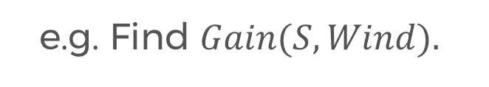
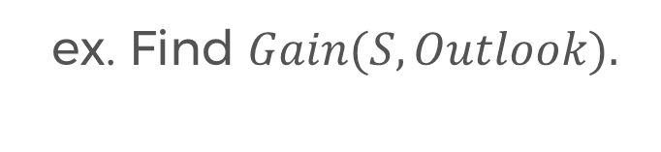
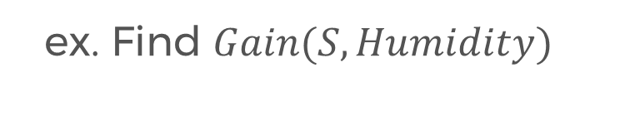
Information Gain
e.g. Find $Gain(S, Wind).$
Answer: 0.048
ex. Find $Gain(S, Humidity)$
Answer: 0.151
ex. Find $Gain(S, Outlook).$
Answer: 0.246

Slide 41
EXERCISE OPTIONS
Solve by hand / calculator (takes a lot of time!)
Use python to program the automatic computation of entropies and information gain.
- Make sure to handle log₂ 0
Advanced: Implement decision trees using Python!
- Requires some knowledge on recursion, classes
Notes:
Please use only the three colors for the content.

Slide 42
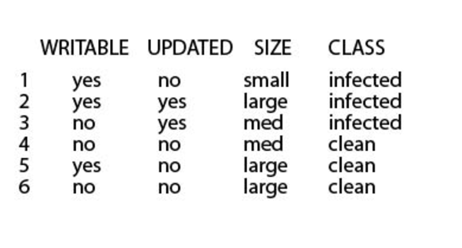
Partner/Group/Individual Exercise
Predicting virus infection in files:
Notes:
Please use only the three colors for the content.

Slide 43
Challenge
Classify the type of vegetation that is likely to grow in areas of land based on descriptive feature.
ID | Stream | Slope | Elevation | Vegetation
1 | False | Steep | High | Chapparal
2 | True | Moderate | Low | Riparian
3 | True | Steep | Medium | Riparian
4 | False | Steep | Medium | Chapparal
5 | False | Flat | High | Conifer
6 | True | Steep | Highest | Conifer
7 | True | Steep | High | Chapparal
Notes:
No required

Slide 44
What type of vegetation would likely grow on terrain with a steep slope and medium elevation and is near a stream?
Notes:
Please use only the three colors for the content.

Slide 45
Partner/Group/Individual Presentation
Notes:
Please use only the three colors for the content.

Slide 46
References
Decision Tree Lecture by Victor Lavrenko (Youtube)
Notes:
Please use only the three colors for the content.

Slide 47
T.I.L.
SHARE IT!
In front!
On Twitter: @wwcodemanila
Or FB: fb.com/wwcodemanila
Don’t forget to tag WWCodeManila so we can retweet or share it.
Notes:
Please use only the three colors for the content.

Slide 48
Feedback Form
https://goo.gl/YzSqcS
Please don’t rate the event on meetup.
Not helpful. It is best to just tell your concerns via the feedback form. We are a building a community not a Yelp restaurant.
Notes:
Please use only the three colors for the content.

Slide 49
THANK YOU :)
Notes:
Please use only the three colors for the content.

